Slide 1
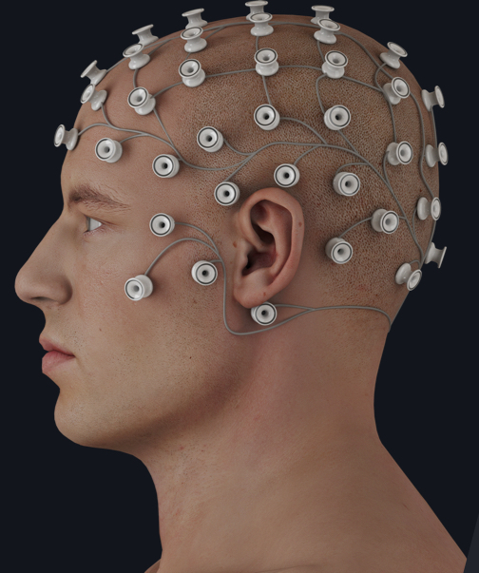



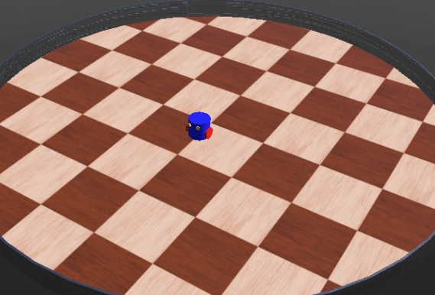
Deep Learning and Signal Processing for Robot Control using Brain Signals: A Python Implementation
Brain-machine Interface with Deep Learning
ROSE 2023 Tutorials Session
Goragod Pongthanisorn¹, Sivapong Nilwong², Genci Capi¹
¹ Hosei University, Tokyo, Japan
² Thai-Nichi Institute of Technology, Bangkok, Thailand

Slide 2
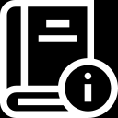
Section Outline
Introduction to Brain-machine Interface
Electroencephalogram
Signal Visualization
Deep Learning and BMI application
Implementation of DL BMI with PyTorch

Slide 3
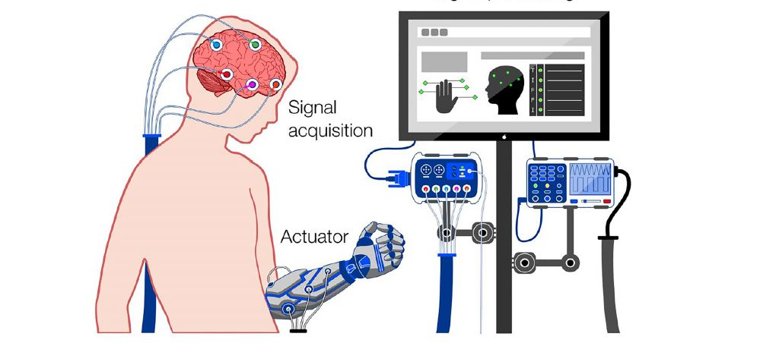
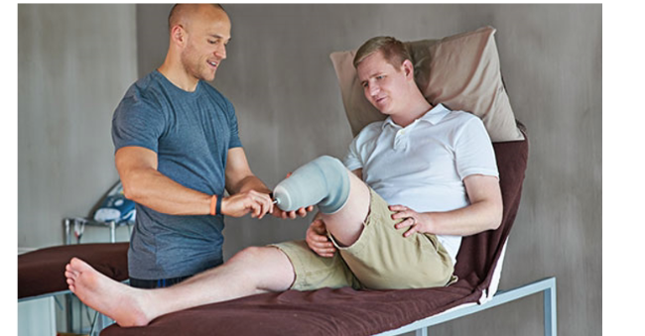
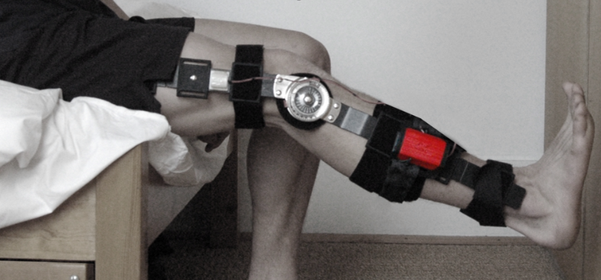
Brain-machine Interface (BMI)
Brain-machine Interface is a system that realize subjects’ intention / thoughts via brain activity that is produced.
Example Application of BMI
Medical and Rehabilitation
Emotion Recognition
Visual/Perception reconstruction
Introduction

Slide 4
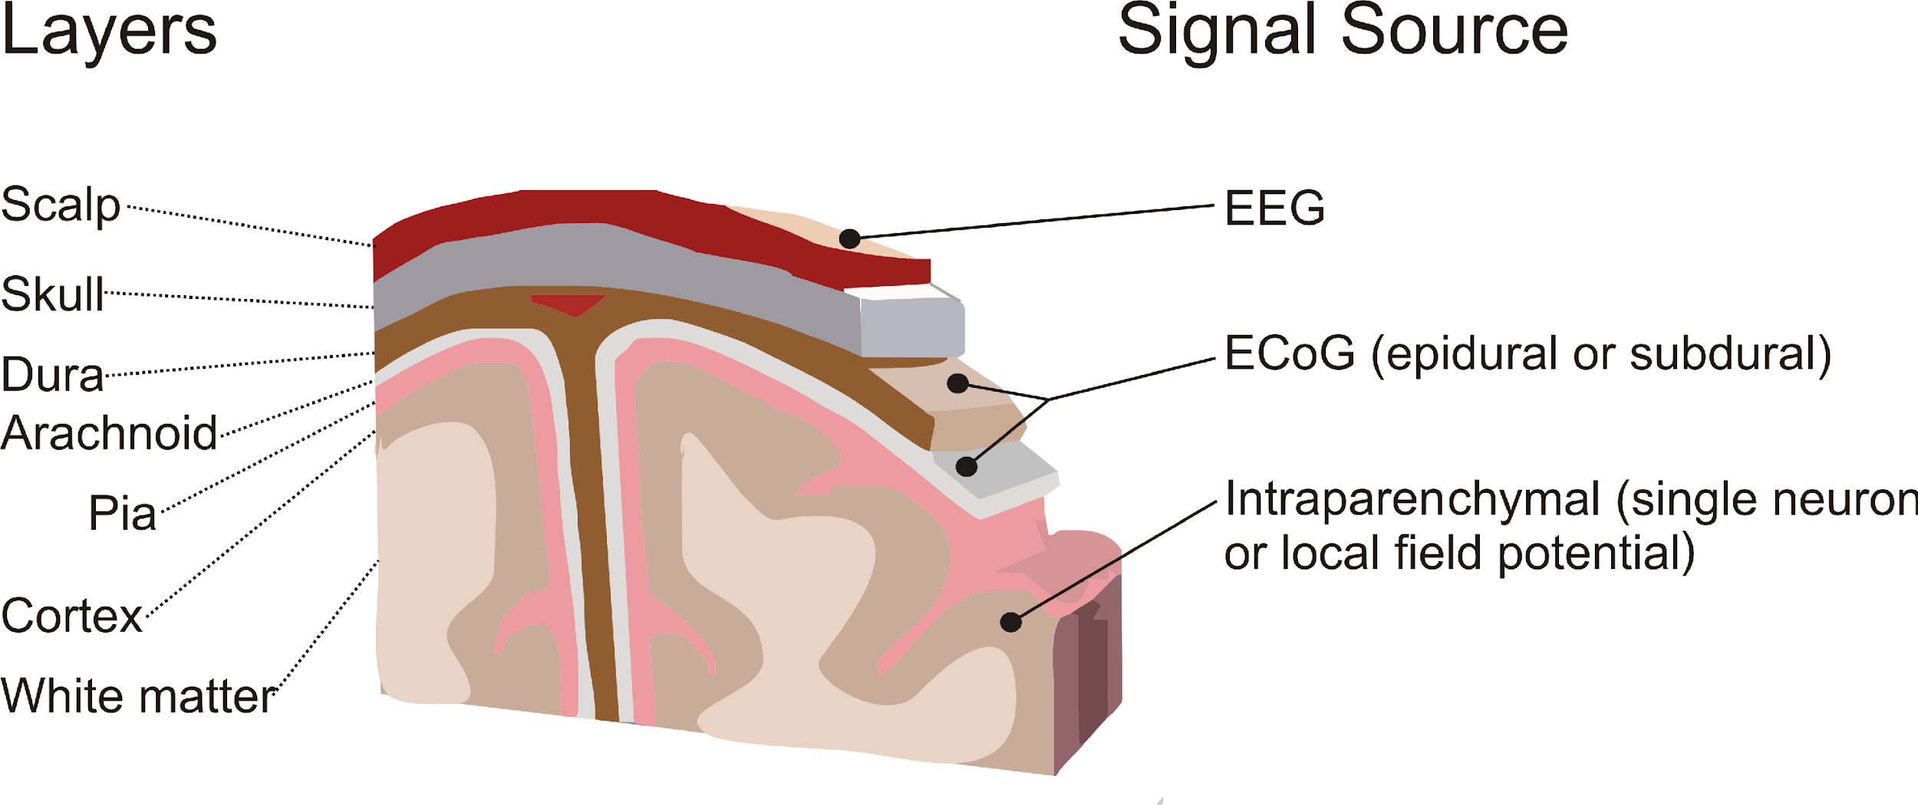
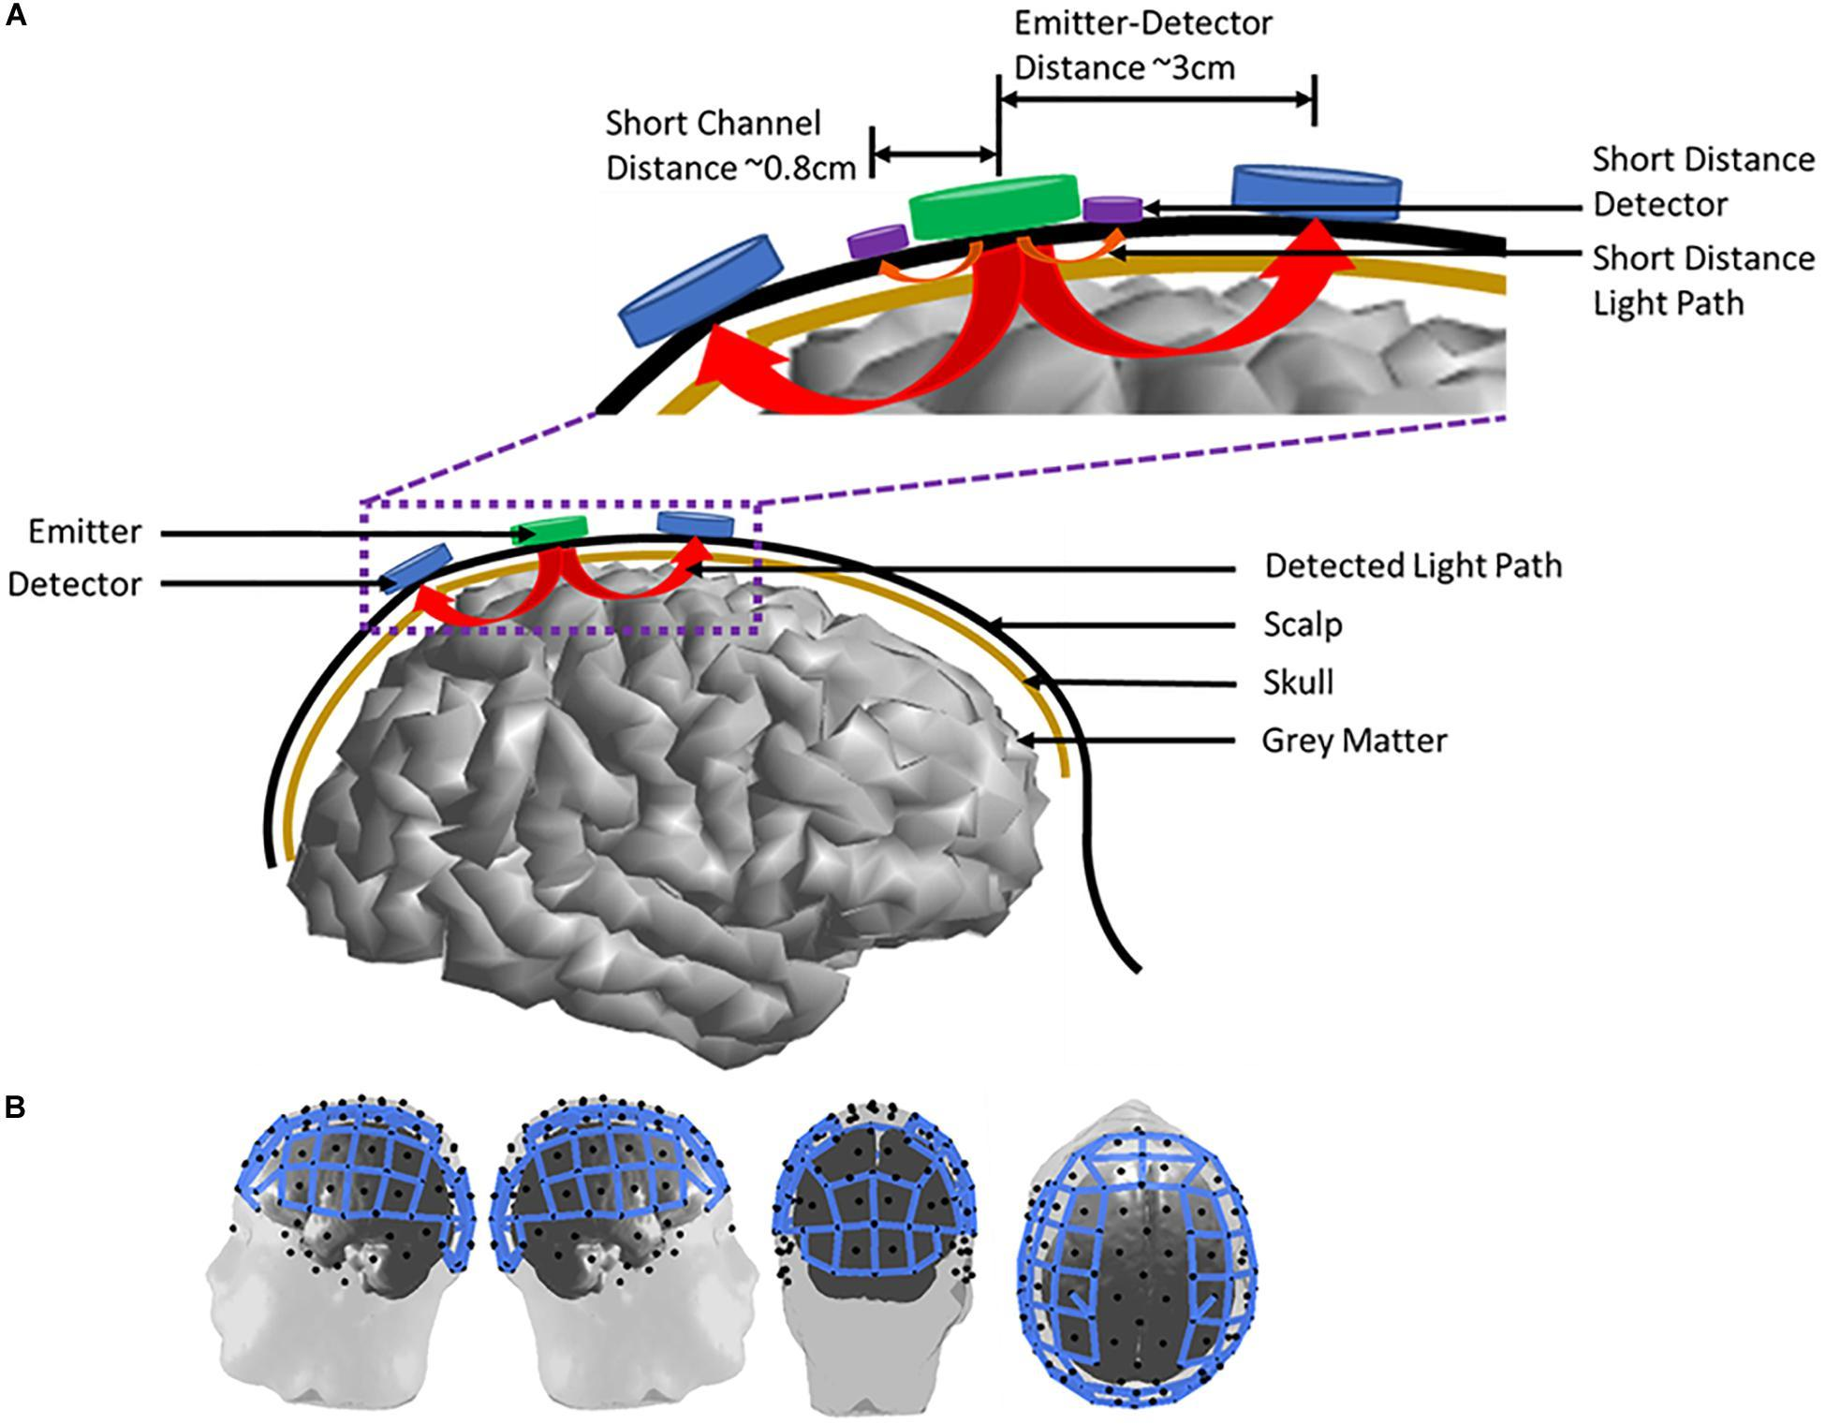
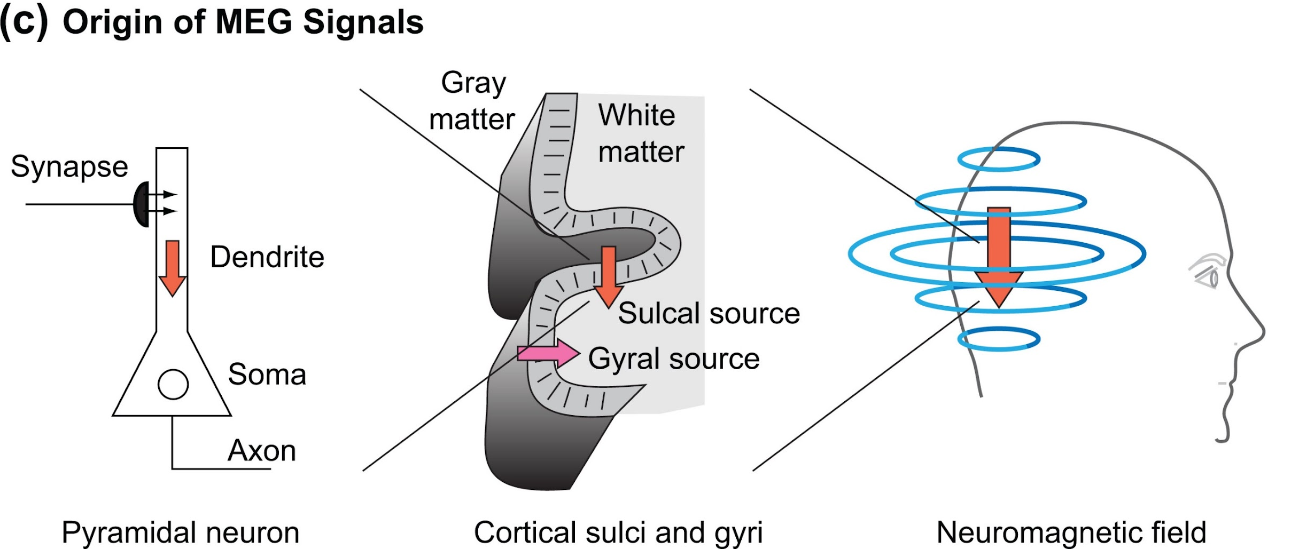
Brain Signals Categorized by signal acquisition methods
Invasive Method
These method require an operation in order to place the electrodes directory to the outer or inner cortical area of the brain
Electrocorticography (ECoG)
Intracortical
Non-invasive Method
These method require no operation but utilize the technique to measure the brain-signal on outer part of subject head
Electroencephalogram (EEG)
Magnetoencephalogram (MEG)
Functional Magnetic Resonance Imaging (fMRI)
Functional Near-infrared Spectroscopy (fNIRS)
Source: https://www.neurotechcenter.org/research/brain-computer-interfacing
Overview of MEG (F.P.Ahlfors et.al., 2016)
FNIRs (W.L Chen et.al., 2020)
ROS Installation

Slide 5
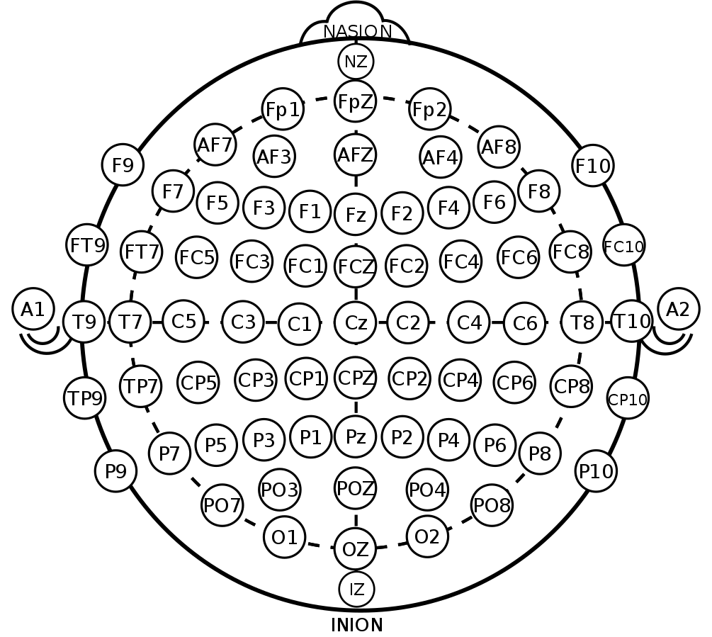
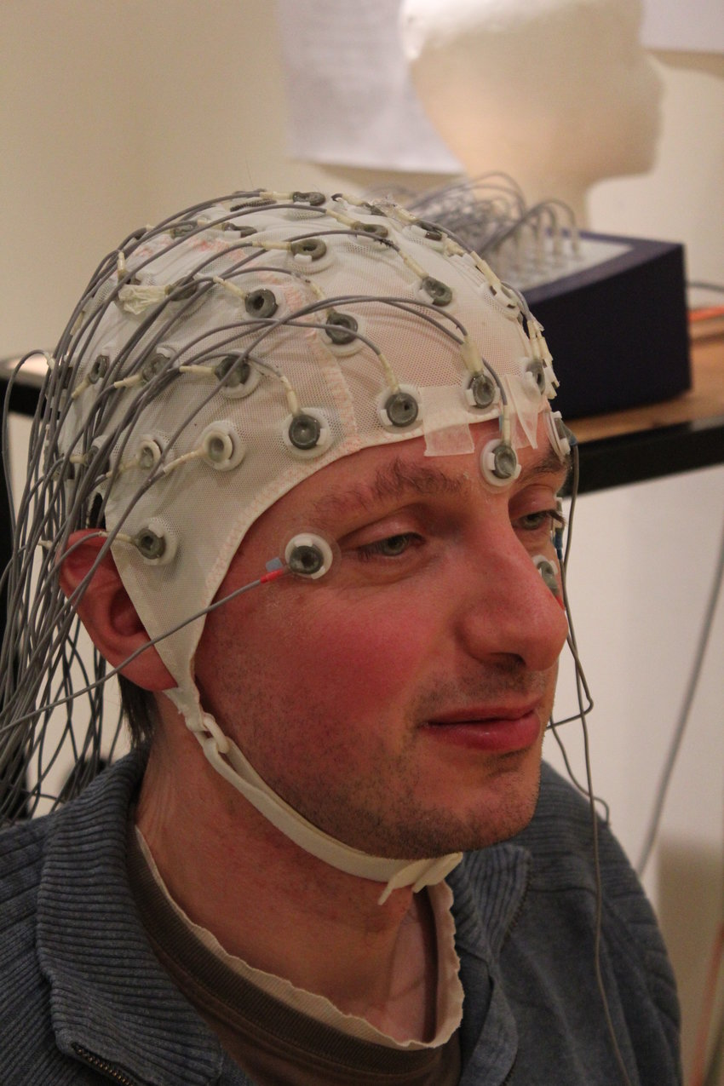
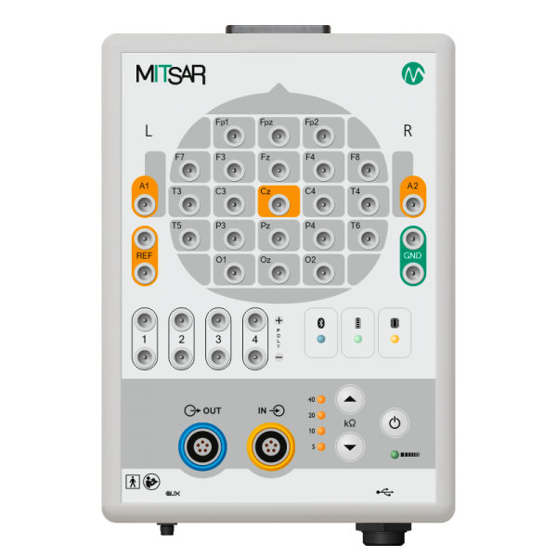
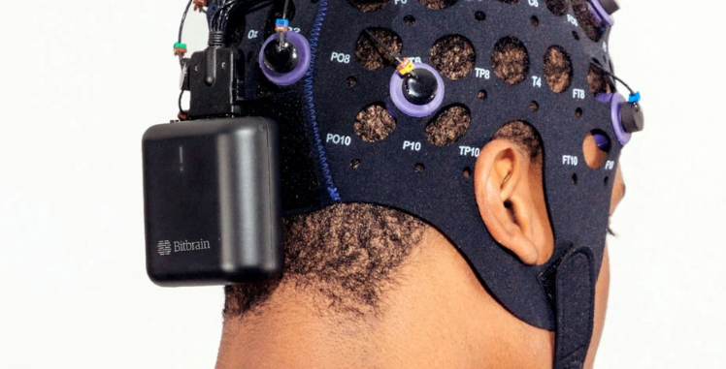
Electroencephalogram (EEG)
Definition: An EEG is a recording of the electrical activity of your brain. The electrodes are placed on the user scalp and detect tiny electrical charges that result from the activity of your brain cells. The charges are amplified and appear as a graph on a computer screen. (Hopkin Medicine , access in October 2023)
An electrode location usually referred as Channel which strictly follow the standard placement (e.g. 10-20 System)
Number of channel and sampling rate may vary, depending on the device
Electrodes can be gel-based or dry
Electrical charge from brain activity is relatively small, thus, it is amplified.
Thesis (Daniel L. 2017)
Source: https://www.sv.uio.no/psi/english/research/projects/human-time-data/documents/data-lifecycle/eeg/2.%20electrode-placement/
ROS Installation

Slide 6
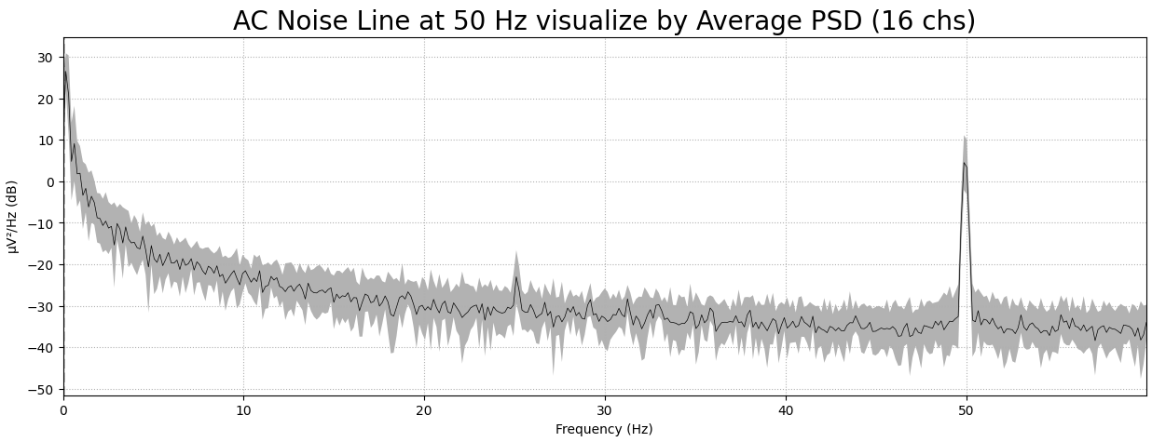
Electroencephalogram (EEG) cont. EEG noise types and removal technique
External Noise: cause by electromagnetic of surrounding devices/power line such as
AC Noise Line – Typically at 50 or 60Hz
Magnetic field emit by another electrical devices
Unstable contact of the electrodes
DC Offset
Internal Noise: Cause by unintentional motion which produce other kind of bio-signal when recording EEG such as
Electrocardiography (ECG) – Produce by heart
Electrooculography (EOG) – Produce by eye-movement
Electromyography (EMG) – Produce by muscles
Noise Removal Technique for EEG
Independent Component Analysis (ICA)
Signal Space Projection (SSP)
Principle Component Analysis (PCA)
Filter Design
Wavelet Transform (Discrete and Continuous)
Re-reference / Cross reference of EEG channels
Source: https://www.sv.uio.no/psi/english/research/projects/human-time-data/documents/data-lifecycle/eeg/2.%20electrode-placement/
ROS Installation

Slide 7
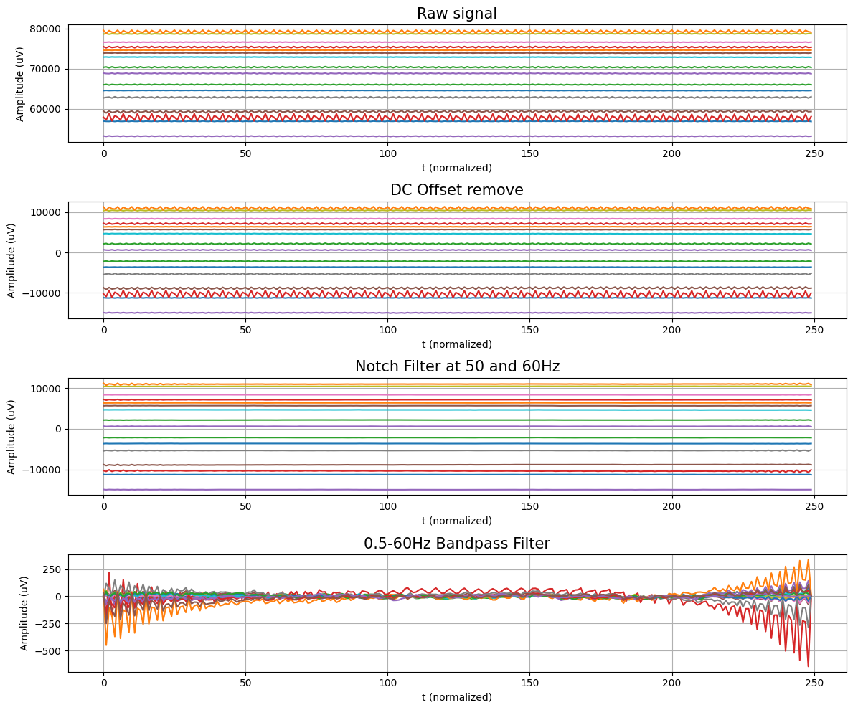
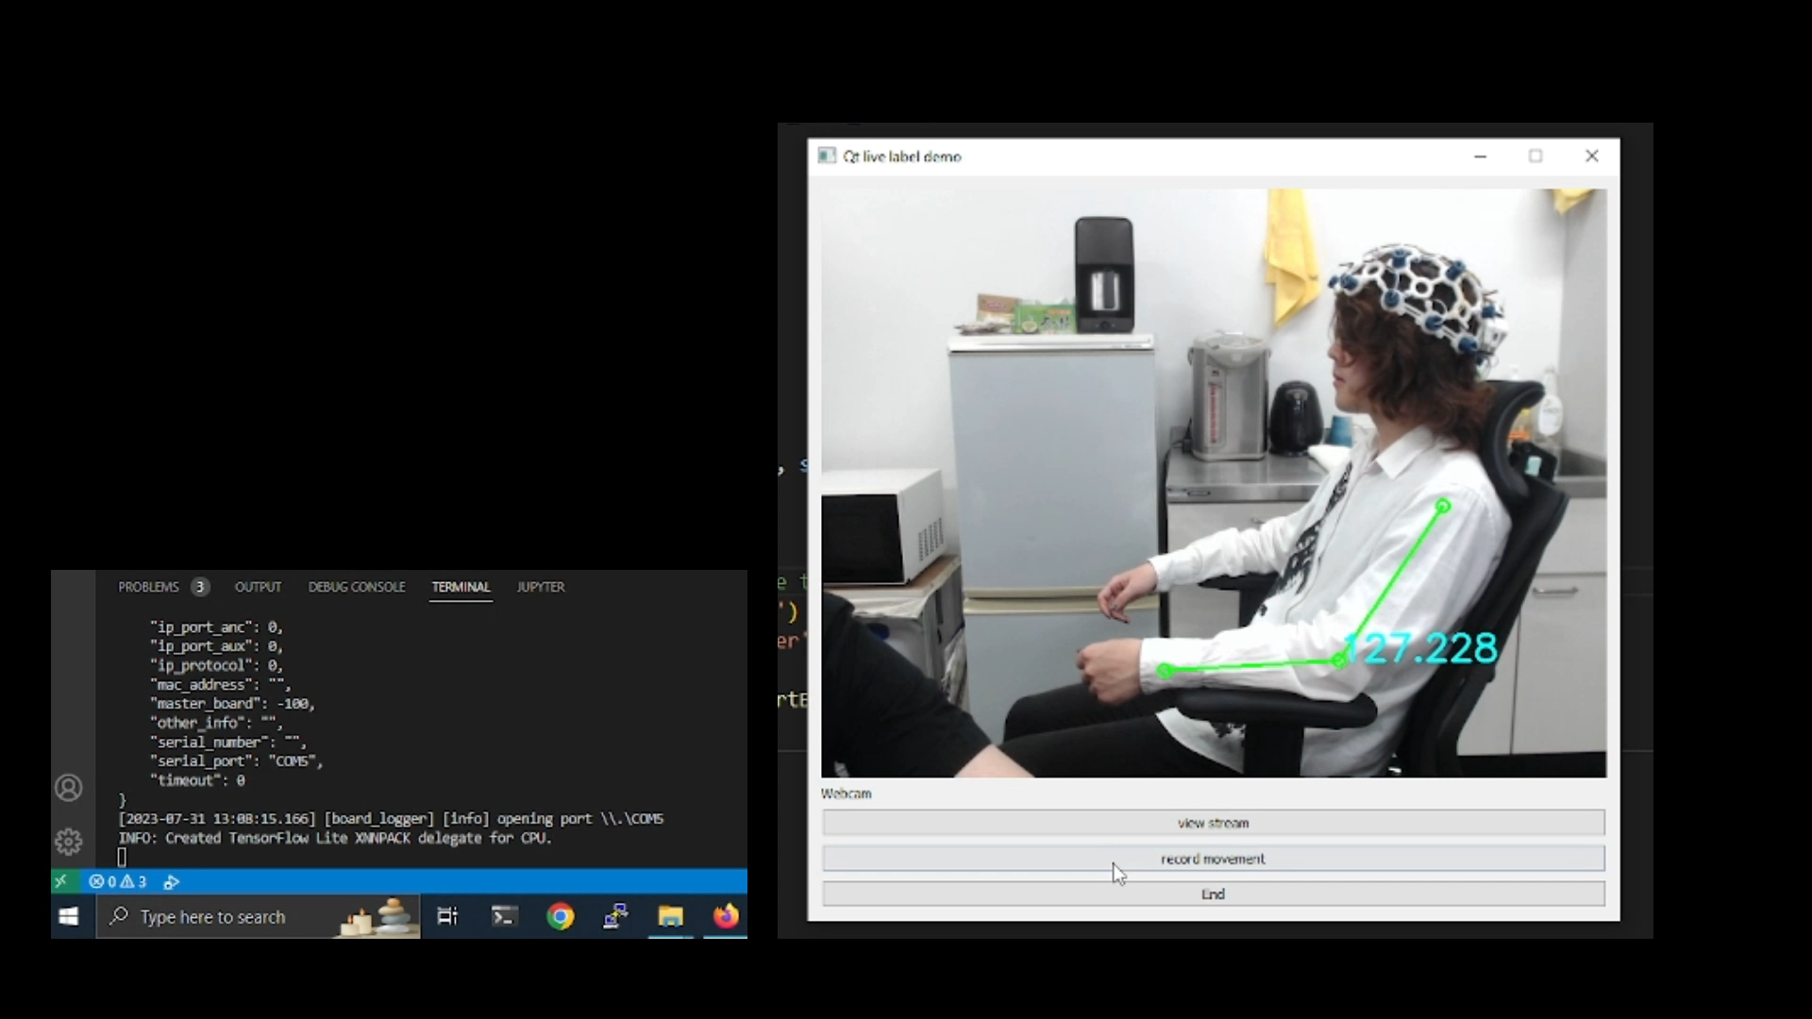
Electroencephalogram (EEG) cont. example of preprocessing of multi-channels EEG signal
Case Study
EEG signal recording at 125 Hz recording during subject’s elbow flexing using OpenBCI 16-channels and BrainFlow library
**Maximum measurable frequency is 62.5Hz, as restrict by Nyquist
*** This is for demonstration only, another dataset will be used further.
ROS Installation

Slide 8
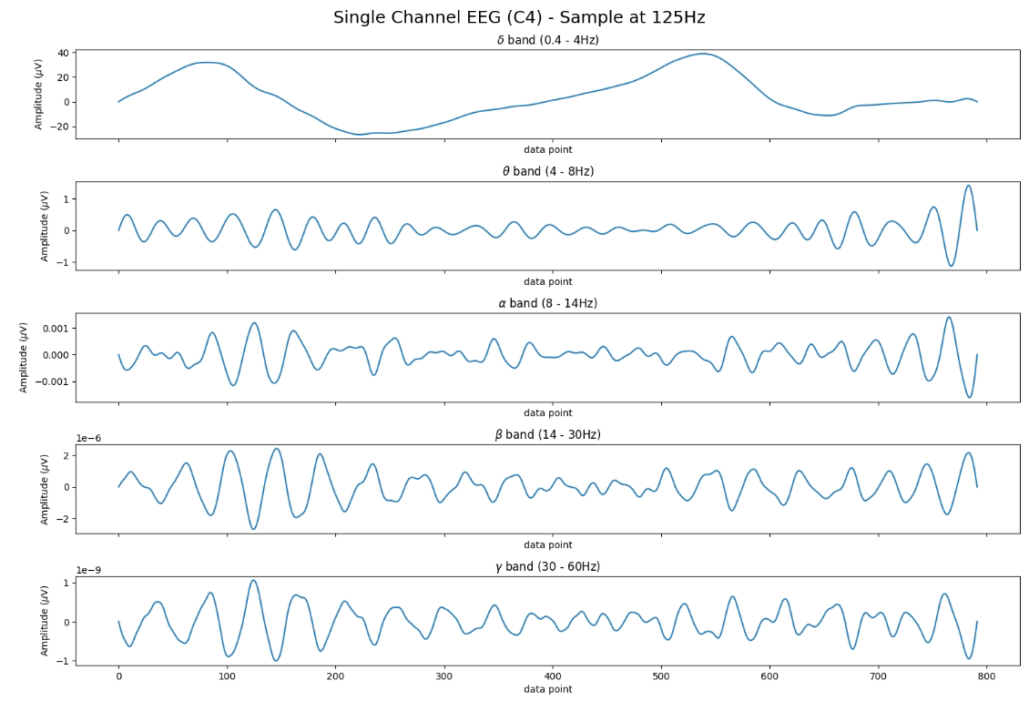
Electroencephalogram (EEG) cont. EEG Frequency Components
Delta wave (δ) 0.4 – 4 Hz
Theta wave (θ) 4 – 8Hz
Alpha wave (α) 8 – 14Hz
Beta wave (β) 14 – 30Hz
Gamma wave (γ) 30Hz or more
ROS Installation

Slide 9
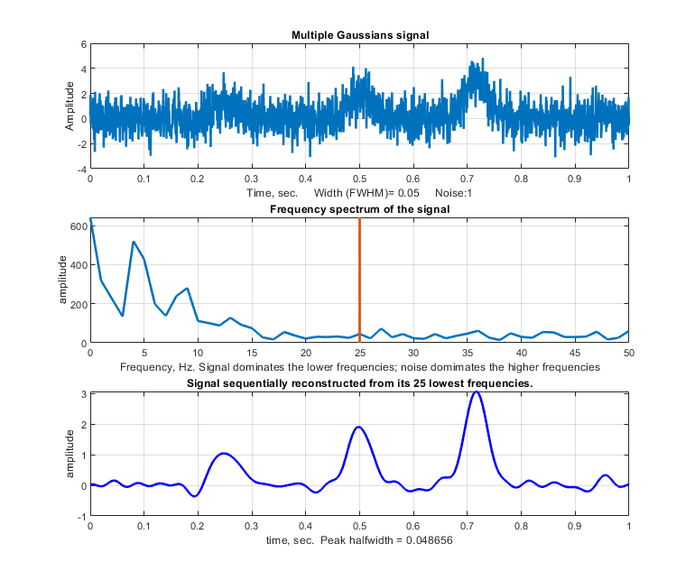
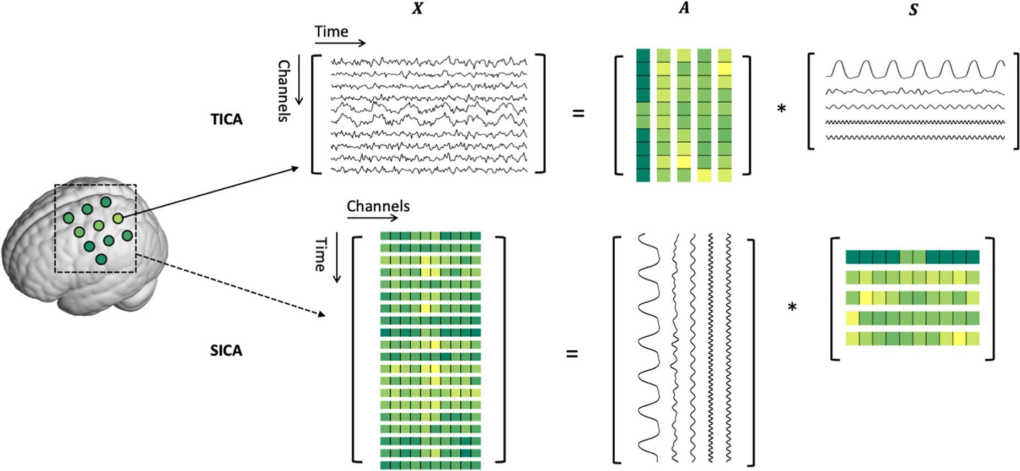
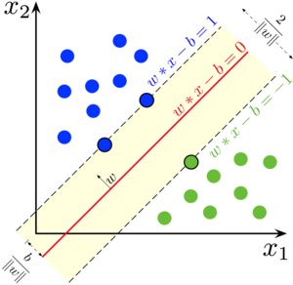
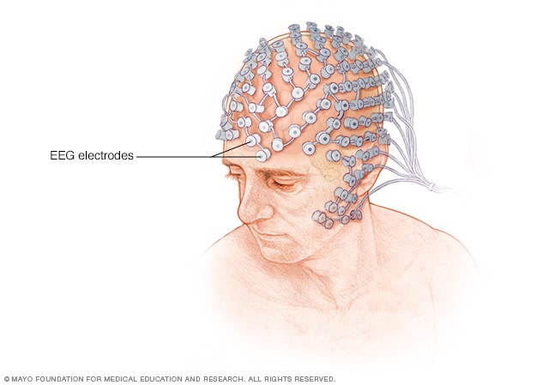
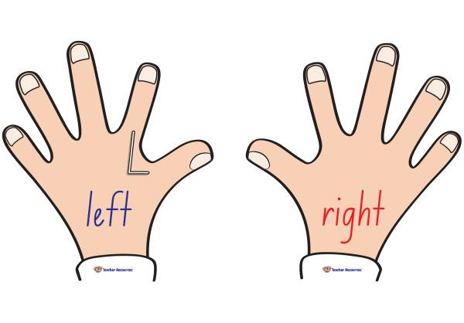
Typical Approach for BMI
1 Signal Acquisition
2 Preprocessing + Feature Engineering
3 Estimation
4 Output Mapping
Various techniques are applied to remove noise/artifacts from original signal with minimal effect to the original signal e.g., ICA,PCA
Feature engineering is performed on clean-signal to extract feature for the classifier e.g., CSP
Output from classifier is interpreted and send command to control external device
LR, SVM or KNN etc., is used as classifier
Subject with EEG recording device (+amplifier)
This is traditional approach that had been used by many BMI system for several years.
ROS Installation

Slide 10
Limitation of previous approach
The inherent non-stationary nature of the recorded signals
The high inter-subject variability in the characteristics of brain signals, even intra-subject
Spatial/temporal information preprocessing and feature extraction require an expertise in brain function
ROS Installation

Slide 11
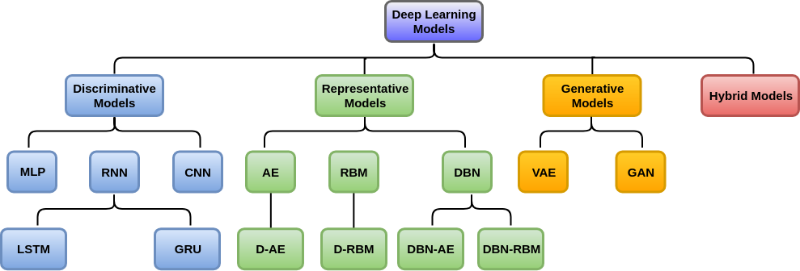
Deep Learning
Deep Learning (DL) is a machine learning subfield that uses multiple-layers for learning data representations making it exceptionally effective at learning patterns
DL provides a flexible, learnable framework for representing visual, text, linguistic information
Can learn in supervised and unsupervised manner
DL represents an effective end-to-end learning system
Since about 2010, DL has outperformed other ML techniques
ROS Installation

Slide 12
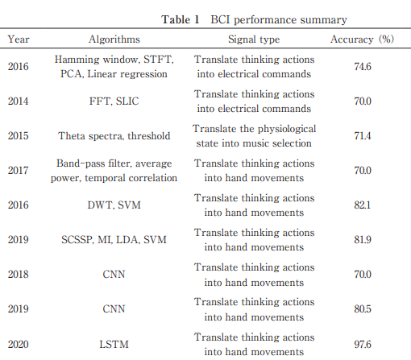
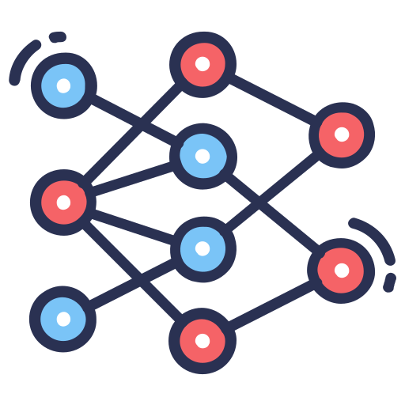
Deep Learning in BMI
1 Signal Acquisition
2 Automatic Feature Engineering
3 Output Mapping
Output from classifier is interpreted and send command to control external device
Subject with EEG recording device (+amplifier)
Raw signal is fed to the DL model to perform a learning
DL-based BMI is outperforms traditional approach with minimal preprocessing require
Ability to directly extract the feature and learn hierarchical representations from high-dimensional data
High-learning parameter is suitable for high-dimensional data such as EEG
Review of Performance Improvement of a Noninvasive Brain-computer Interface in Communication and Motor Control for Clinical Applications (Y.Saito et.al., 2023)
ROS Installation

Slide 13
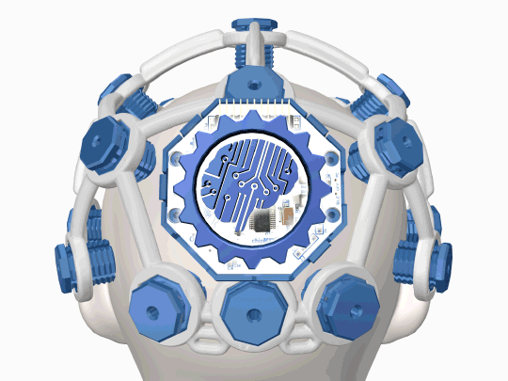
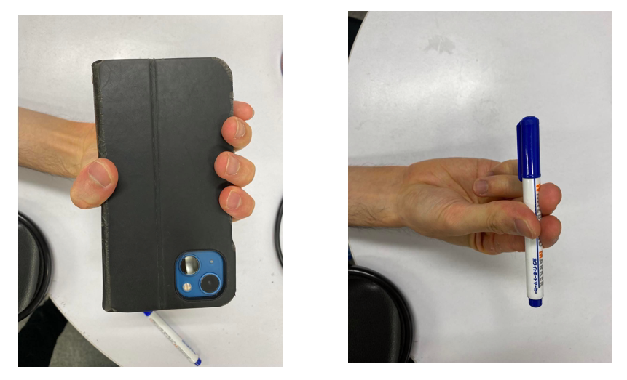
Case Study of DL-BMI
Objective : Create a DL model that distinguish grasping gesture of the subject using EEG signal
idle
3-fingers grasping
5-fingers grasping
Recording Device: OpenBCI 8-channels
OS: Ubuntu 22.04 LTS
Programming: Python 3.10.12
Target gesture
Introduction

Slide 14
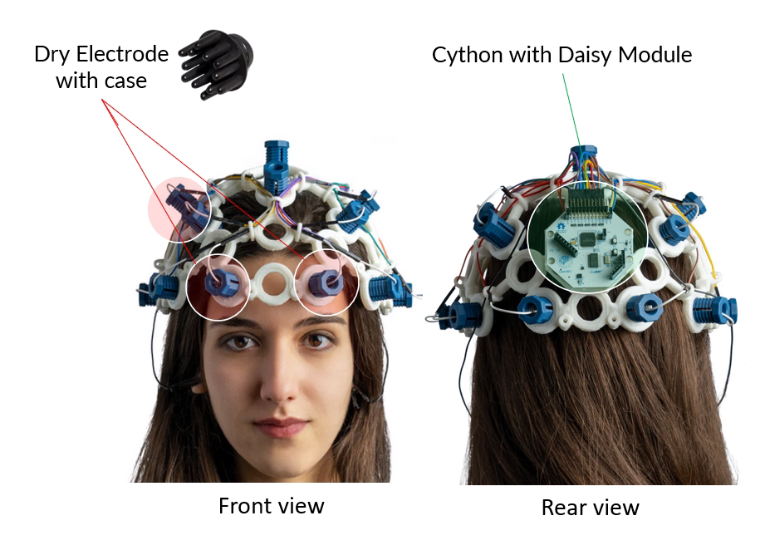
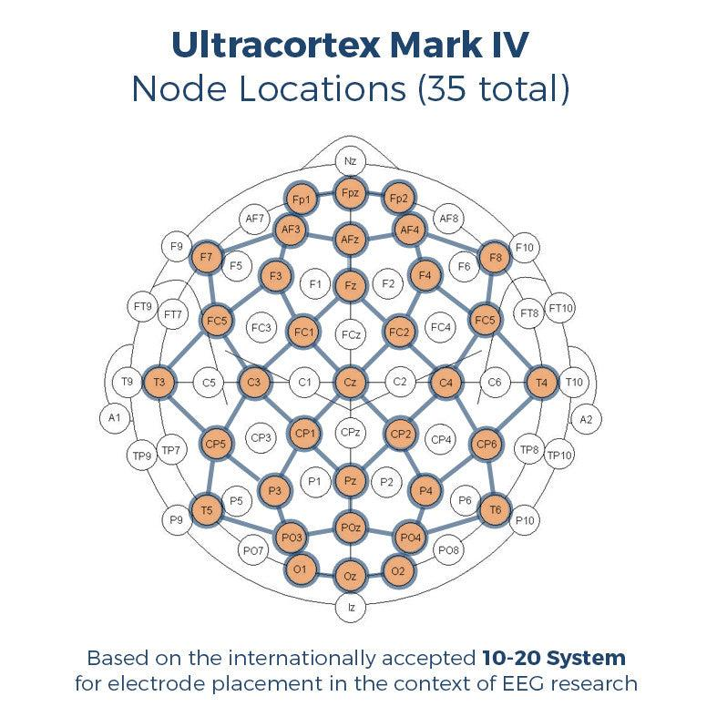
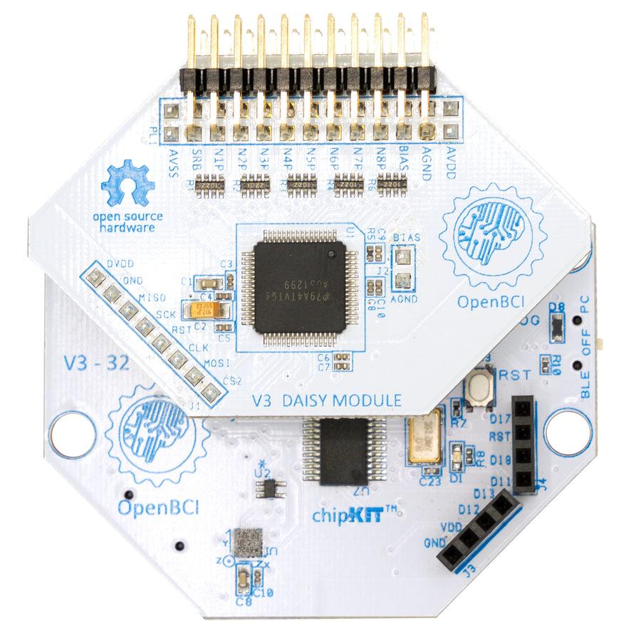
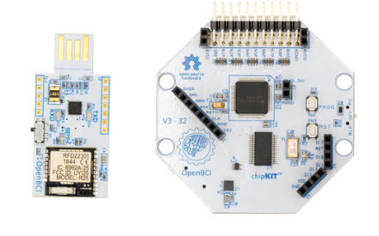
OpenBCI Device
Sampling Rate: 250Hz (standalone)
125Hz (Daisy module connected)
Number of Channels: 8 (standalone)
16 (Daisy module connected)
Electrode Type: Dry
Electrode Location: Standard 10-20 System
Interface: BLE 4.0
Sync/Recording Lib Lab Streaming Layer (LSL)
BrainFlow
ROS Installation

Slide 15
Deep Learning and Visualization Library for BMI
Basic computation and visualization
NumPy – Vector/Matrix Numeric computation library for Python
Matplotlib – Plotting library
SciPy – Scientific computation (e.g. filter) in Python
Neuro-Physiological signal Processing
MNE
Torcheeg
PyLSL (require installation of LSL library)
Deep Learning Library
PyTorch
ROS Installation

Slide 16
Python Deep Learning setup
Step 1: Install Python environment
Ubuntu 22.04 LTS has Python 3.10.12 pre-installed, but essential tools for development must be manually install.
sudo apt update && sudo apt upgrade –y
sudo apt-get install python3-pip python3-dev
ROS Installation

Slide 17
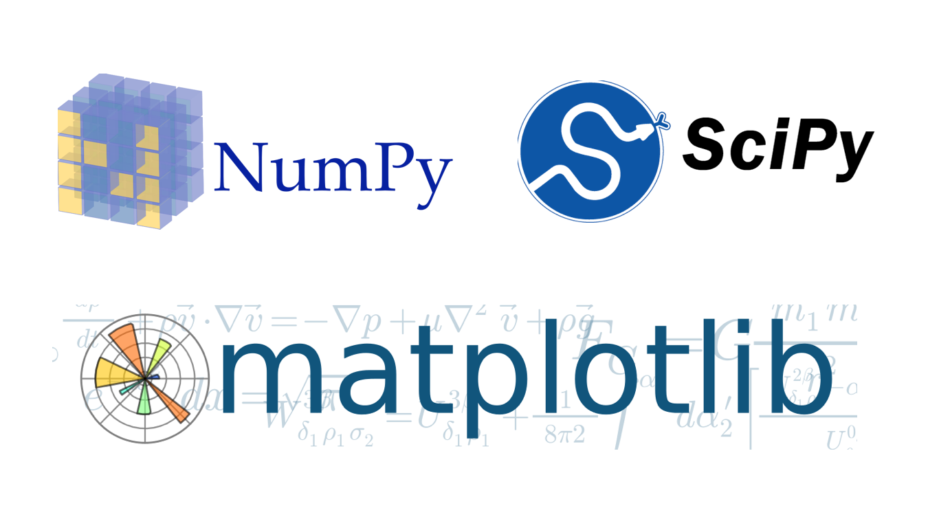
NumPy Scipy Matploblib
Step 2: Install essential library for computation
Make sure that you are using the system’s python3
pip3 install numpy scipy matplotlib opencv-python
ROS Installation

Slide 18

MNE
Step 3: Install neuro-physiological library
pip3 install mne
https://mne.tools/stable/index.html
ROS Installation

Slide 19
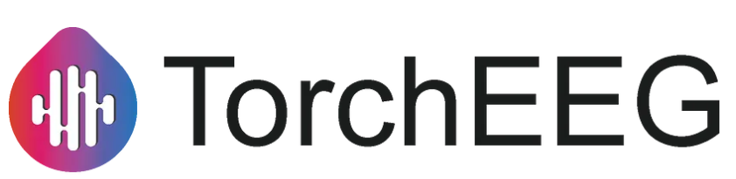

PyTorch and Torcheeg
Step 4: Install Deep Learning framework
Please visit PyTorch website for the latest stable installation command. For using Cuda (GPU acceleration) pre-requisite NVIDIA driver may required,
pip3 install torch torchvision torchaudio --index-url https://download.pytorch.org/whl/cu118
pip3 install torcheeg
ROS Installation

Slide 20
LSL Setup
Step 4:
Visit https://github.com/sccn/liblsl/releases and select the correct version of your OS
Ubuntu 22.04 LTS use liblsl-1.62.2-jammy_amd64.dep (current version)
sudo dpkg –i <path to lsl file>/liblsl-1.62.2-jammy_amd64.dep
If above command produce an error, run this to install dependencies
sudo apt install –f
sudo dpkg –i <path to lsl file>/liblsl-1.62.2-jammy_amd64.dep
Install Python binding of LSL
pip3 install pylsl
ROS Installation

Slide 21
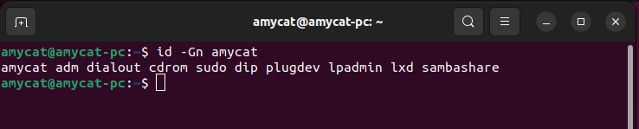
Prepare connection
Step 5:
Check serial permission on current user. There must be dialout permission in current user as follow
id –Gn <user_name>
If not, run this command and restart before proceed further
sudo usermod -a -G dialout <username>
ROS Installation

Slide 22
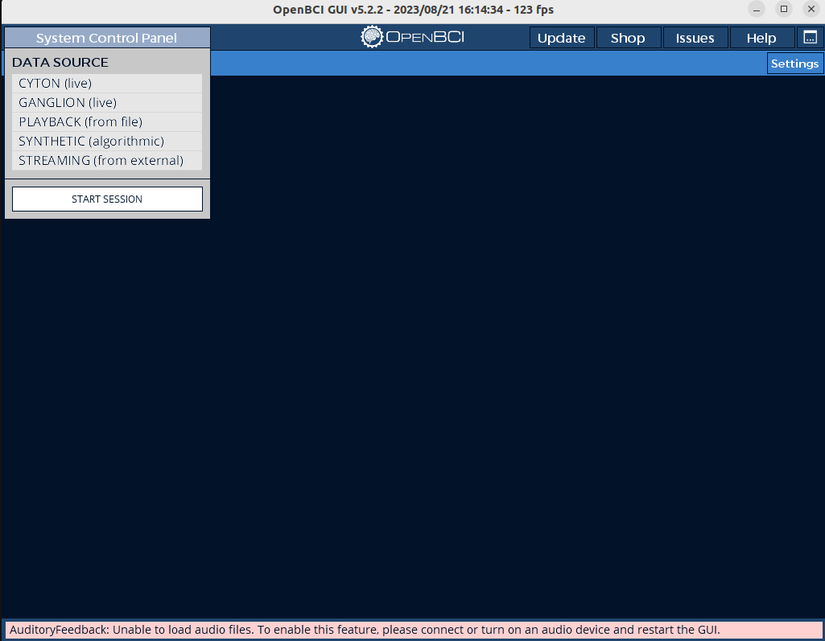
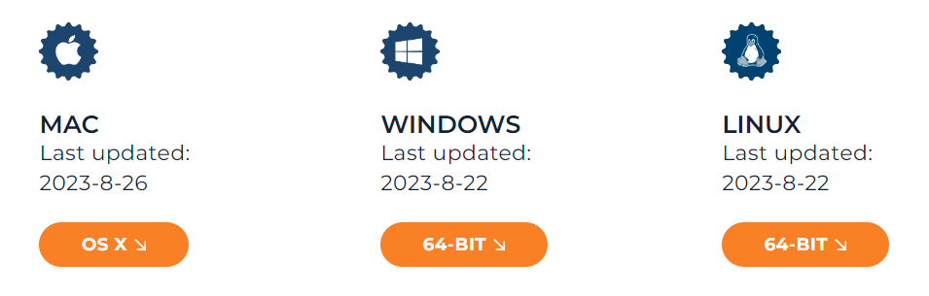
Prepare connection cont.
Step 6:
Download OpenBCI GUI from https://openbci.com/downloads
Navigate to location of BCI and execute this command to start the program
cd <path_to_download_folder>/OpenBCI_GUI
sudo ./OpenBCI_GUI
ROS Installation

Slide 23
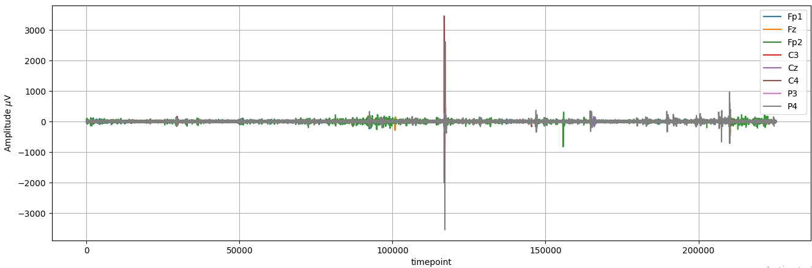
Getting start with the Signal Recording
Related file : simple_recorder.py
Output
signal_.npy – signal read from the device
label_.npy – description of the event in of the signal -2 : cooldown/rest, -1: ready, 0:idle, 1:box and 2:pen
timestamp_.npy recording timestamp from the device
ROS Installation

Slide 24
Getting start with MNE
There are 3 data type in MNE as follow
RawArray – A continuous data with annotation of each event in form of (ch x time)
EpochArray- A segmented signal to each annotated event in annotation in form of (epoch x ch x time)
EvokeArray – A group of same/different event extracted from EpochArray to compute
ROS Installation

Slide 25
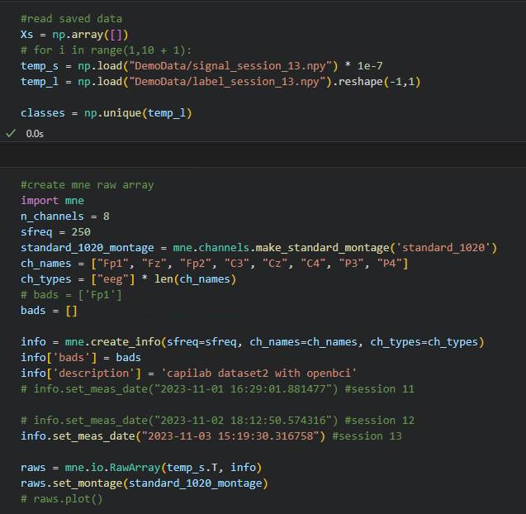
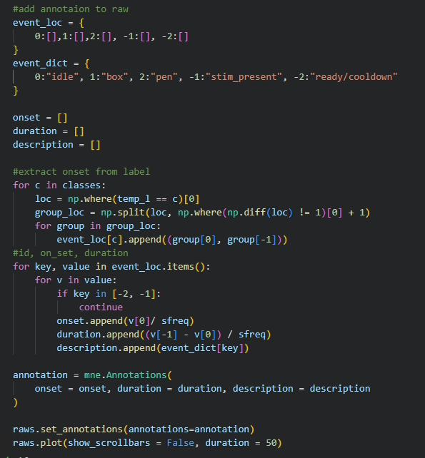
Create RawArray from NumPy array
ROS Installation

Slide 26
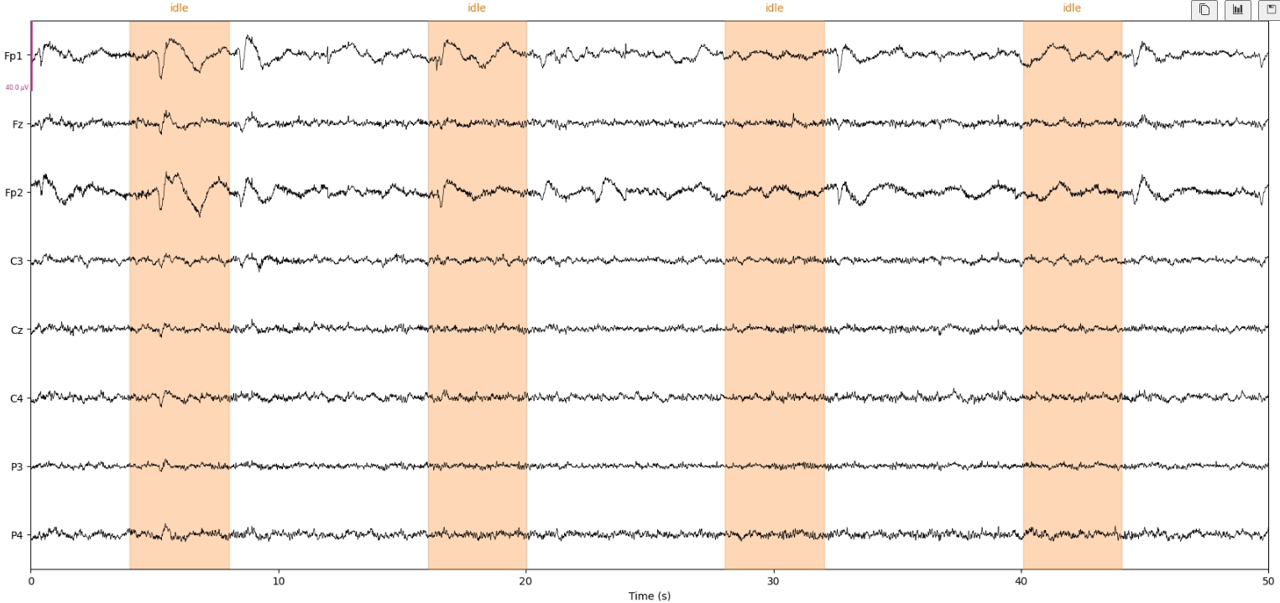
Create RawArray from NumPy array (cont.)
ROS Installation

Slide 27
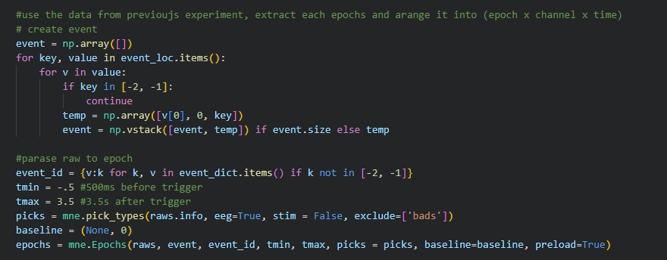
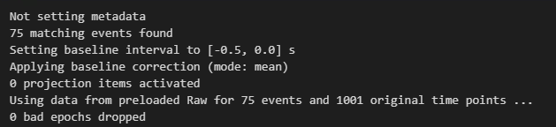
Create EpochArray from RawArray
ROS Installation

Slide 28
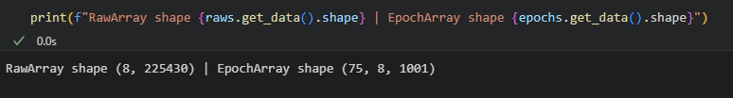
Create EpochArray from RawArray
ROS Installation

Slide 29
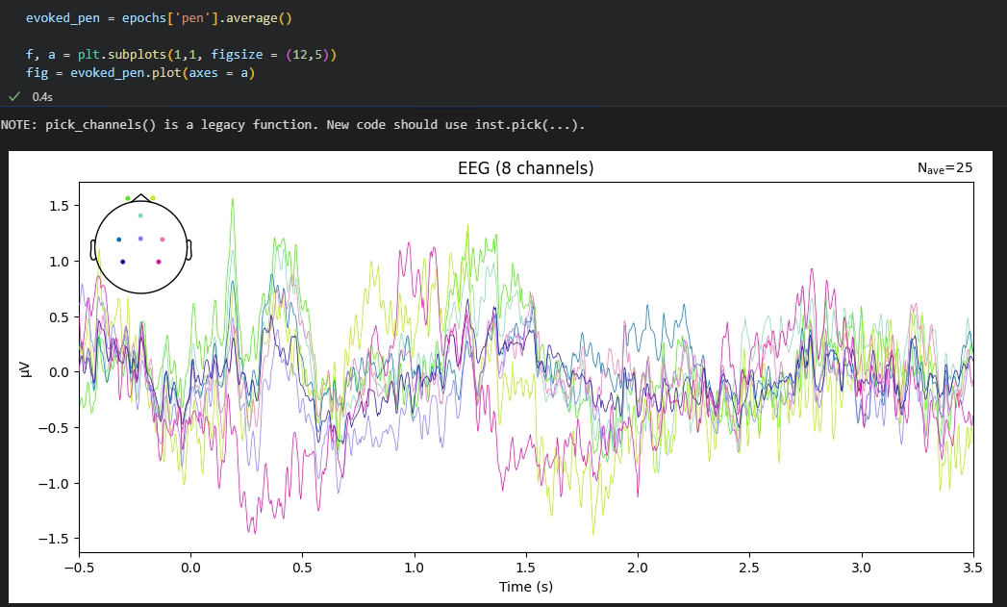
Visualize the data – Evoke Signal
Find the average amplitude of each channel in the same event
ROS Installation

Slide 30
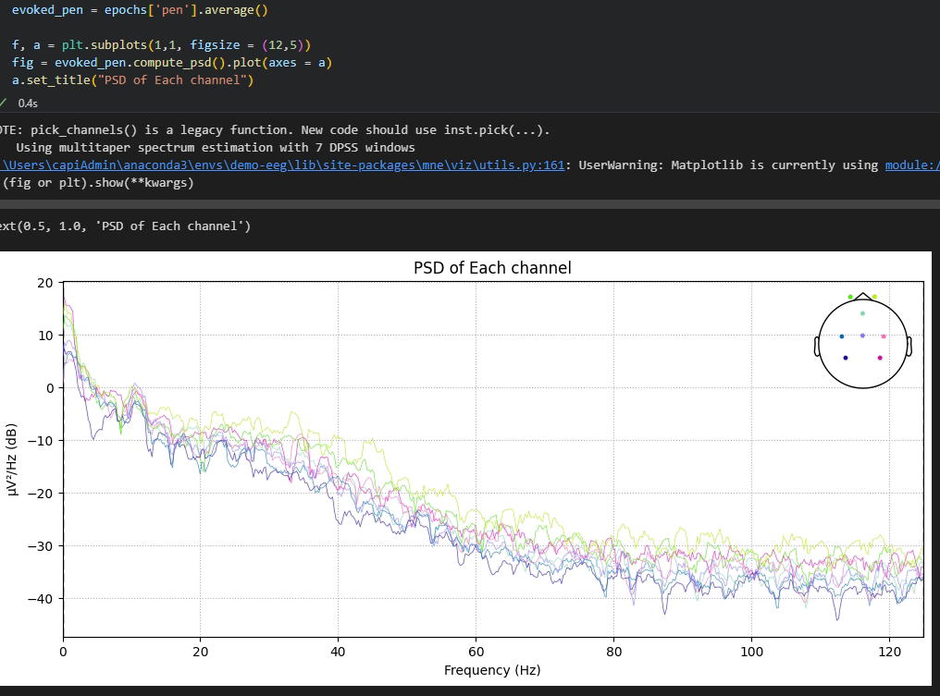
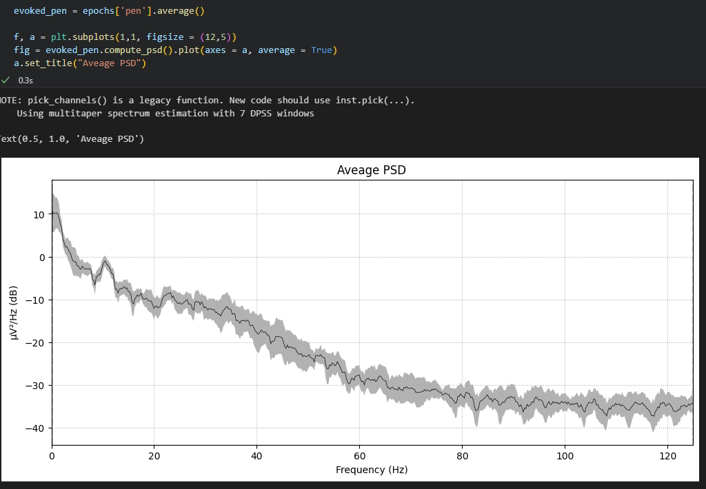
Visualize the data – Evoke Signal
Compute Power Spectral Density of each channel or average
ROS Installation

Slide 31
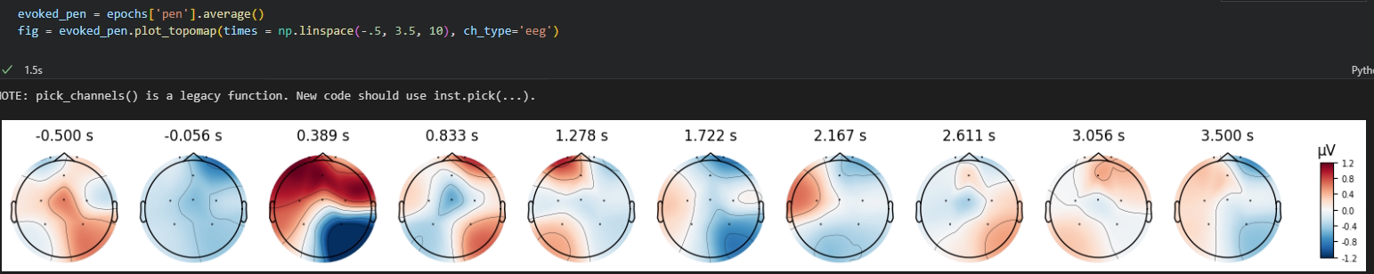
Visualize the data – Evoke Signal
Plot brain-activation heat map at each timestep
ROS Installation

Slide 32
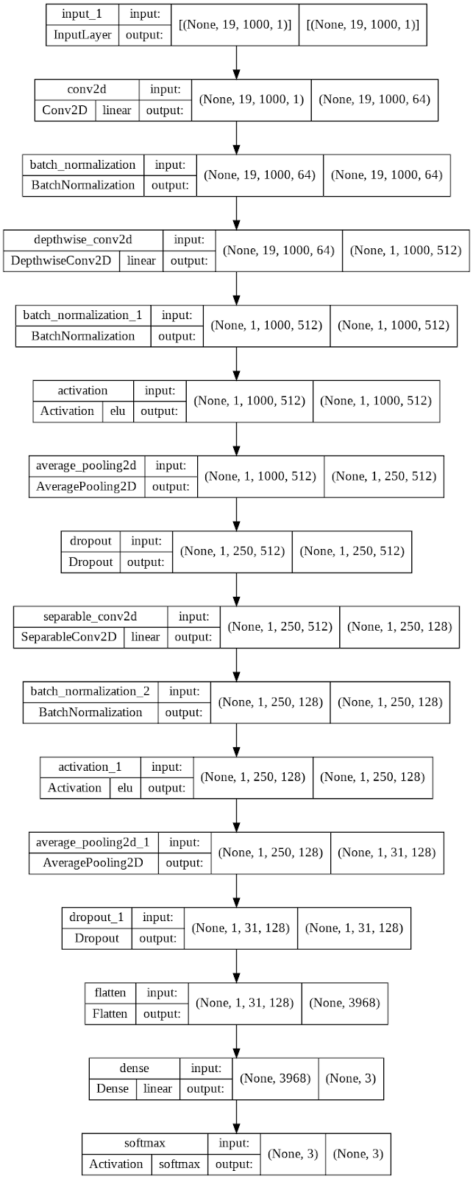
DL Model - EEGNet
Temporal Convolution
Normal convolutional layer that learn spatial filter
Depth-wise Convolution
Learn the feature by feature-map-wise convolution resulting a frequency-specific spatial filter
Separable Convolution
Temporal-spatial fuse convolution that utilize depth-wise convolution to learn temporal summary for each feature map and point-wise convolution to optimally mix the feature map
Classification
Simple fully-connected layer that map the feature map to output classes
ROS Installation

Slide 33
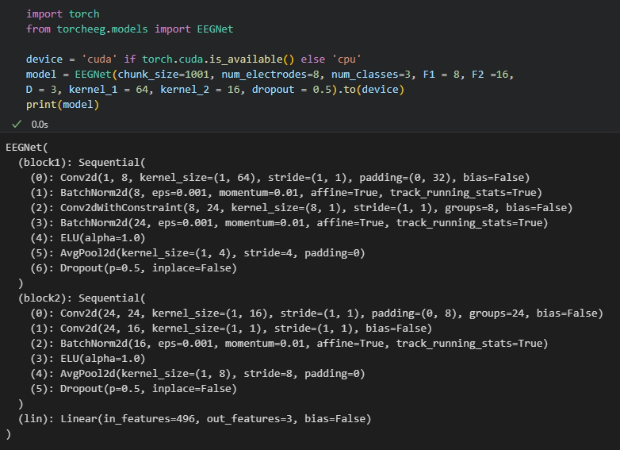
DL Model – EEGNet cont.
ROS Installation

Slide 34
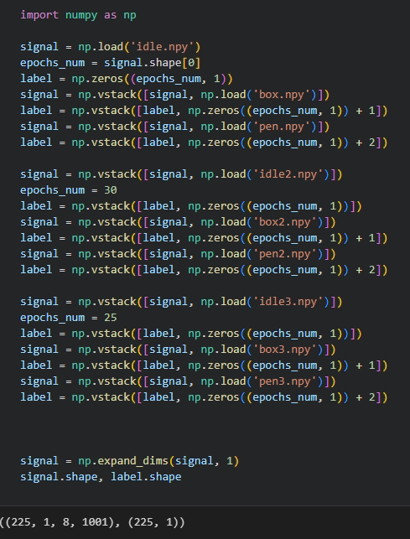

Prepare the data
Load data
Split the data to training and testing set
ROS Installation

Slide 35

Create the dataloader
ROS Installation

Slide 36

Training Loop
ROS Installation

Slide 37

Testing Loop
ROS Installation

Slide 38
End of Section

Slide 39



Section Outline
Introduction
ROS Installation
Webots Simulation Installation
Webots Controls with Input Keys

Slide 40


Introduction
System in this tutorials
ROS version: ROS2 Humble (LTS)
OS: Ubuntu 22.04 LTS
Simulation: Webots
Introduction

Slide 41

ROS Installation
This installation guide works on Ubuntu 22.04 LTS.
Step 1: Check Locale
Use locale in the terminal to check if you have a locale which supports UTF-8.
If UTF-8 is not supported, apply these settings:
sudo apt update && sudo apt install locales
sudo locale-gen en_US en_US.UTF-8
sudo update-locale LC_ALL=en_US.UTF-8 LANG=en_US.UTF-8
export LANG=en_US.UTF-8
ROS Installation

Slide 42
ROS Installation
Step 2: Setup Sources (Recommend copy (Ctrl+C) and paste (Ctrl+Shift+V) to your terminal)
2.1 Ensure Ubuntu Universe repository is enabled, use these commands in terminal:
sudo apt install software-properties-common
sudo add-apt-repository universe
2.2 Add the ROS 2 GPG key with apt.
sudo apt update && sudo apt install curl -y
sudo curl -sSL https://raw.githubusercontent.com/ros/rosdistro/master/ros.key -o /usr/share/keyrings/ros-archive-keyring.gpg
2.3 Add the repository to your sources list.
echo "deb [arch=$(dpkg --print-architecture) signed-by=/usr/share/keyrings/ros-archive-keyring.gpg] http://packages.ros.org/ros2/ubuntu $(. /etc/os-release && echo $UBUNTU_CODENAME) main" | sudo tee /etc/apt/sources.list.d/ros2.list > /dev/null
ROS Installation

Slide 43
ROS Installation
Step 3: Install ROS 2 Packages
3.1 Update apt repository caches.
3.5 (Optional) Add sourcing to shell startup.
sudo apt update
echo "source /opt/ros/humble/setup.bash" >> ~/.bashrc
3.2 Ensure the system (Ubuntu OS) is up to date.
Step 3.5 can help users not to source the setup script every time a new terminal is opened.
sudo apt upgrade
3.3 Install ROS.
sudo apt install ros-humble-desktop
3.4 Install development tools.
sudo apt install ros-dev-tools
ROS Installation

Slide 44




ROS Installation
Summary
1. Check locale (UTF-8)
2. Setup sources
3. Install ROS
ROS Installation

Slide 45

Webots Installation
Webots is an open source and multi-platform desktop application used to simulate robots.
This part includes:
Webots Installation
Basic Simulation
Webots Installation

Slide 46
Webots Installation
Webots can be installed by simply run the following command in the terminal:
sudo apt-get install ros-humble-webots-ros2
We can launch an example by:
1. Setting WEBOTS_HOME environment variable.
export WEBOTS_HOME=/usr/local/webots
2. Use ROS 2 launch to start the demo package.
ros2 launch webots_ros2_universal_robot multirobot_launch.py
Webots Installation

Slide 47
Basic Simulation Setup
This basic simulation will also be used in the example in the final section.
Prerequisites
1. Install colcon
sudo apt install python3-colcon-common-extensions
2. Create workspace
mkdir -p ~/ros2_ws/src
Webots Installation

Slide 48
Basic Simulation Setup
Step 1: Create the package structure
1.1 CD to the src folder of the created workspace (ros2_ws/src)
cd ~/ros2_ws/src
1.2 Create a new package (my_package)
ros2 pkg create --build-type ament_python --license Apache-2.0 --node-name my_robot_driver my_package --dependencies rclpy geometry_msgs webots_ros2_driver
1.3 Add launch and worlds inside the created my_package folder
cd my_package
mkdir launch
mkdir worlds
Webots Installation

Slide 49
Basic Simulation Setup
Step 2: Setup the simulation world
Download the world file from ROS site:
https://docs.ros.org/en/humble/_downloads/5ad123fc6a8f1ea79553d5039728084a/my_world.wbt
Place the downloaded world file inside my_package/worlds/
Webots Installation

Slide 50
Basic Simulation Setup
my_package/my_package/my_robot_driver.py
import rclpy
from geometry_msgs.msg import Twist
HALF_DISTANCE_BETWEEN_WHEELS = 0.045
WHEEL_RADIUS = 0.025
class MyRobotDriver:
def init(self, webots_node, properties):
self.__robot = webots_node.robot
self.__left_motor = self.__robot.getDevice('left wheel motor')
self.__right_motor = self.__robot.getDevice('right wheel motor')
self.__left_motor.setPosition(float('inf'))
self.__left_motor.setVelocity(0)
self.__right_motor.setPosition(float('inf'))
self.__right_motor.setVelocity(0)
self.__target_twist = Twist()
rclpy.init(args=None)
self.__node = rclpy.create_node('my_robot_driver')
self.__node.create_subscription(Twist, 'cmd_vel', self.__cmd_vel_callback, 1)
def __cmd_vel_callback(self, twist):
self.__target_twist = twist
def step(self):
rclpy.spin_once(self.__node, timeout_sec=0)
forward_speed = self.__target_twist.linear.x
angular_speed = self.__target_twist.angular.z
command_motor_left = (forward_speed - angular_speed * HALF_DISTANCE_BETWEEN_WHEELS) / WHEEL_RADIUS
command_motor_right = (forward_speed + angular_speed * HALF_DISTANCE_BETWEEN_WHEELS) / WHEEL_RADIUS
self.__left_motor.setVelocity(command_motor_left)
self.__right_motor.setVelocity(command_motor_right)
Step 3: Edit my_robot_driver
my_robot_driver is a sub-package that automatically creates a ROS 2 interface for sensors.
We can extend this interface to create a robot controller.
Open my_package/my_package/my_robot_driver.py in an editor and replace its contents with contents as follows (recommend copy and paste):
Webots Installation

Slide 51
Basic Simulation Setup
Step 4: Create the my_robot.urdf file
my_robot.urdf is used to declare the plugin. This plugin can be connected to the target robot.
Create a text file named my_robot.urdf in my_package/resource with this content:
<?xml version="1.0" ?>
<robot name="My robot">
<webots>
<plugin type="my_package.my_robot_driver.MyRobotDriver" />
</webots>
</robot>
Webots Installation

Slide 52
Basic Simulation Setup
my_package/launch/robot_launch.py
import os
import launch
from launch import LaunchDescription
from ament_index_python.packages import get_package_share_directory
from webots_ros2_driver.webots_launcher import WebotsLauncher
from webots_ros2_driver.webots_controller import WebotsController
def generate_launch_description():
package_dir = get_package_share_directory('my_package')
robot_description_path = os.path.join(package_dir, 'resource', 'my_robot.urdf')
webots = WebotsLauncher(
world=os.path.join(package_dir, 'worlds', 'my_world.wbt')
)
my_robot_driver = WebotsController(
robot_name='my_robot',
parameters=[
{'robot_description': robot_description_path},
]
)
return LaunchDescription([
webots,
my_robot_driver,
launch.actions.RegisterEventHandler(
event_handler=launch.event_handlers.OnProcessExit(
target_action=webots,
on_exit=[launch.actions.EmitEvent(event=launch.events.Shutdown())],
)
)
])
Step 5: Create the launch file
The launch file can help launching the simulation and ROS controller with a single command.
Create a new text file robot_launch.py in my_package/launch with this content:
Webots Installation

Slide 53
Basic Simulation Setup
my_package/setup.py
from setuptools import setup
package_name = 'my_package'
data_files = []
data_files.append(('share/ament_index/resource_index/packages', ['resource/' + package_name]))
data_files.append(('share/' + package_name + '/launch', ['launch/robot_launch.py']))
data_files.append(('share/' + package_name + '/worlds', ['worlds/my_world.wbt']))
data_files.append(('share/' + package_name + '/resource', ['resource/my_robot.urdf']))
data_files.append(('share/' + package_name, ['package.xml']))
setup(
name=package_name,
version='0.0.0',
packages=[package_name],
data_files=data_files,
install_requires=['setuptools'],
zip_safe=True,
maintainer='user',
maintainer_email='user.name@mail.com',
description='TODO: Package description',
license='TODO: License declaration',
tests_require=['pytest'],
entry_points={
'console_scripts': [
'my_robot_driver = my_package.my_robot_driver:main',
],
},
)
Step 6: Edit setup.py
We need to edit setup.py in our package to include files added in previous steps, so that the files are available for use.
Webots Installation

Slide 54

Basic Simulation Setup
Step 7: Test the code
7.1 Build and run simulation with following commands (in workspace folder):
colcon build
source install/local_setup.bash
ros2 launch my_package robot_launch.py
7.2 Open another terminal and send a command to the robot:
ros2 topic pub /cmd_vel geometry_msgs/Twist "linear: { x: 0.1 }"
Webots Installation

Slide 55

Webots Controls with Input Keys
This part introduces an example of how to control a robot in Webots using a simple publisher.
This part includes:
Introduction to Publisher
Robot Controls using Input Keys
Webots Controls with Input Keys

Slide 56

ROS Publisher
ROS includes with nodes, executables that communicates with other nodes using ROS.
These nodes basically communicate through the topics, or the channels.
Nodes that send messages are publishers.
Nodes that receive messages are subscribers.
Source: https://docs.ros.org/en/humble/Tutorials/Beginner-CLI-Tools/Understanding-ROS2-Topics/Understanding-ROS2-Topics.html
Webots Controls with Input Keys

Slide 57
Robot Controls
From previous section, we can notice that the robot receive data from a topic named cmd_vel through subscribing, as written in my_robot_driver.py.
Message type is Twist, including linear and angular values for the robot.
self.__node.create_subscription(Twist, 'cmd_vel', self.__cmd_vel_callback, 1)
Webots Controls with Input Keys

Slide 58
Robot Controls
my_package/my_package/robot_control.py
To send messages to the robot, we can create a publisher node for the topic cmd_vel.
This is a publisher modified from the “minimal_publisher” in https://docs.ros.org/en/humble/Tutorials/Beginner-Client-Libraries/Writing-A-Simple-Py-Publisher-And-Subscriber.html
This publisher asks users to input a command to the robot every 1 second:
w : move forward (linear.x = 0.2)
s : move backward (linear.x = -0.2)
a : rotate left (angular.z = 0.2)
d : rotate right (angular.z = -0.2)
import rclpy
from rclpy.node import Node
from geometry_msgs.msg import Twist
from std_msgs.msg import String
class robotController(Node):
def __init__(self):
super().__init__('robot_control')
self.publisher_ = self.create_publisher(Twist, 'cmd_vel', 10)
timer_period = 1 # seconds
self.timer = self.create_timer(timer_period, self.timer_callback)
def timer_callback(self):
cms = Twist()
key = input('Robot command: ')
if(key=='w'):
cms.linear.x = 0.2
elif(key=='s'):
cms.linear.x = -0.2
elif(key=='a'):
cms.angular.z = 0.2
elif(key=='d'):
cms.angular.z = -0.2
else:
cms.linear.x = 0.0
cms.angular.z = 0.0
self.publisher_.publish(cms)
def main(args=None):
rclpy.init(args=args)
robot_control = robotController()
rclpy.spin(robot_control)
robot_control.destroy_node()
rclpy.shutdown()
if __name__ == '__main__':
main()
Webots Controls with Input Keys

Slide 59

Robot Controls
After saving the publisher file “robot_control.py” to my_package/my_package/ folder in the workspace, we need to modify the setup.py to add an entry point for the publisher.
In this case, we named it “robot_control”.
Webots Controls with Input Keys

Slide 60
Robot Controls
Build and run simulation with following commands:
cd ~/ros2_ws
colcon build
source install/local_setup.bash
ros2 launch my_package robot_launch.py
Then launch the robot_control to control the robot in an another terminal.
cd ~/ros2_ws
source install/local_setup.bash
ros2 run my_package robot_control
Webots Controls with Input Keys

Slide 61

Robot Controls
Webots Controls with Input Keys

Slide 62
End of Section

Slide 63
Ref
Ding Y, Robinson N, Zhang S, et al. Tsception: Capturing temporal dynamics and spatial asymmetry from EEG for emotion recognition[J]. arXiv preprint arXiv:2104.02935, 2021.
Zhang X, Yao L. Deep Learning for EEG-Based Brain-Computer Interfaces: Representations, Algorithms and Applications[M]. 2021.
Lawhern V J, Solon A J, Waytowich N R, et al. EEGNet: a compact convolutional neural network for EEG-based brain-computer interfaces[J]. Journal of neural engineering, 2018, 15(5): 056013.
Yang Y, Wu Q, Fu Y, et al. Continuous convolutional neural network with 3D input for EEG-based emotion recognition
Rudakov E, Laurent L, Cousin V, et al. Multi-Task CNN model for emotion recognition from EEG Brain maps

